Slide 1

Win 11 Train the Trainer: Deployment
Before we start . . .
To improve your experience in this meeting here are some tools that can help
LIVE Captions in your own language
Zoom your screen in/out
Please mute your line, so all can hear well
Please post your questions in the chat
If you need anything else to help you have the best experience in this meeting, please let us know in the chat
Agenda
W11 Overview (eden)
Deployment Strategy (eden)
Comms Overview (eden)
Upgrade PC (eden)
Replace PC: Direct Ship (Jeff)
Replace PC: Legacy (Jeff)
Troubleshooting (Sriram/Kamal)

Slide 2
Win 11 Train the Trainer: Deployment
Overview
Benefits
Timelines
Scope
Changes from W10 to W11

Slide 3




Win 11 Overview
W11 Benefits
Supports GSK’s Objectives Windows 11 is aligned with GSK’s Journey to Cloud initiative. | Improved User Experience Streamlined interface resulting in faster PC startup and productivity-focused features to help foster creativity and collaboration. | Advanced Security Robust built-in security features which provide a firm technological foundation to GSK’s policies to safeguard data and privacy of the company, colleagues, & customers in the digital landscape. | New Features! New & enhanced features which create a more accessible and inclusive work experience.
W11 Scope | Upgrade PC | Replace PC: Planned & Budgeted | Replace PC for W11 Update | TOTALS
COMM | 9052 | 2290 | 837 | 12179
GF | 12232 | 2714 | 965 | 15910
GH | 283 | 49 | 10 | 342
GSC | 22632 | 6570 | 3024 | 32226
RD | 16710 | 3413 | 1316 | 21439
VIIV | 1560 | 198 | 112 | 1870
 | 62468 | 15234 | 6264 | 83966
W11 23H2 Production via Autopilot build method for non-regulated PCs
W11 23H2 in Production
W11 new builds
W10 end of support: Oct 25
Changes from Win 10 to Win 11
For details of the technical changes included in Win 11 please see Microsoft’s What’s New in Windows. GSK also has specific build changes in Windows 11 that include: Active Directory goes to the cloud with the move to Azure Active Directory. Autopilot Build is a new way of pre-configuring devices without needing to connect to the GSK network to do so. It allows GSK to work with vendors like HP and Lenovo to ship PCs directly from their warehouses to GSK end-users. Windows Hello for Business Intune’s Company Portal replaces Software Center. Ivanti Secure Access Client replaces Pulse Secure. Office 64-bit current channel replaces Office 32-bit semi-annual channel.
Jan | Feb | Mar | Apr | May | Jun | Jul | Aug | Sep | Oct | Nov | Dec
build
app testing pilot
deploy
W11 LTSC
all dates are subject to change
W11 Milestones | BRAG | Target Date
Deployment Comms Review Begins | G | 3 Jun 24
Train Support Staff (Deploy) | G | w/e 7 Jun
App Testing Complete | G | 28 Jun 24
Pilot Begins | G | 11 Jun 24
Deployment Begins |  | 11 Jul 24
Move 90% of eligible PCs to W11 |  | 31 Dec 24
Win 10 Update
W10 21H2 will be tombstoned as of end-June. This means:
end of W10 build support
move to the new hardware models with W11 installed mid-end July
target is all new hires will receive W11 PCs as of August

Slide 4
Win 11 Train the Trainer: Deployment
Deployment Strategy
PC Eligibility
PC Readiness
PC Targeting
Ramp-up & Waves
Exceptions & Special Handling
2 Deployment Tracks
Upgrade PC
Replace PC

Slide 5
Win 11 Deployment Prep
Deployment Schedule
Ramping up deployment done by site in waves (1 wave/week) and 3-4 phases/wave Starting with larger sites first See the W11 Site Deploy Schedule for order of sites.
Move 90% of eligible PCs to W11 by 31 Dec 24
PC Eligibility
Is compatible with Windows 11 Is at Windows 10 Is users’ primary PC (replacement only) Is targeted to be replaced in 2025 or later (upgrade only) | Has >16 GB RAM Has >25GB free disk space Not in ENV/OT Not LTSC PC Is an Office Device Not a server or virtual PC Has GSKSync in active status | Shared PC (may need special handling) Exec (may need special handling) Multiple PC (upgrade only)
PC Targeting
Target no more than 15% of ready PCs at a site on any day Targeting 4 days/week
Exceptions | Special Handling
PC is delayed in upgrading due to: Application failure Site audit or site closure | User needs a varied version of the standard communication Execs Replace PC
PC Readiness
Once eligibility is determined, then readiness is assessed in Dashworks Readiness is based on the status of scripted BU Apps and documented exceptions for non-scripted BU Apps
Ramp-up & Waves | W1 | W2 | W3 | W4 | W5 | W6 | W7 | W8 | W9 | W10 | W11 | W12 | W13 | W14 | W15 | W16 | W17 | W18 | W19 | W20 | W21 | W22 | W23 | W24
Upgrade PC | 200 | 1000 | 1550 | 1900 | 2750 | 3500 | 4300 | 4654 | 4277 | 4371 | 4013 | 3855 | 3750 | 3941 | 4480 | 4173 | 3683 | 3103 | 2719 | 2199 | 1226 | 276
Upgrade Lag (15 days @ 30%) |  |  | 60 | 300 | 465 | 570 | 825 | 1050 | 1290 | 1396 | 1283 | 1311 | 1204 | 1157 | 1125 | 1182 | 1344 | 1252 | 1105 | 931 | 816 | 660 | 368 | 83
Replace PC: Direct Ship | 0 | 0 | 0 | 0 | 200 | 600 | 1000 | 1500 | 1700 | 1850 | 2011 | 2048 | 2166 | 1893 | 1432 | 1442 | 1218 | 900 | 586 | 541 | 305 | 51
Replace PC: Legacy | 0 | 0 | 0 | 0 | 75 | 225 | 290 | 350 | 410 | 450 | 555 | 540 | 519 | 463 | 368 | 232 | 158 | 120 | 52 | 47 | 43 | 0
Deployment Waves | 200 | 1000 | 1610 | 2200 | 3490 | 4895 | 6415 | 7554 | 7677 | 8067 | 7862 | 7754 | 7639 | 7454 | 7405 | 7029 | 6403 | 5375 | 4462 | 3718 | 2390 | 987 | 368 | 83

Slide 6


Win 11 Deployment Tracks
Upgrade PC |  | Replace PC
See GSK-wide announcements Attend a W11 Preview Session Content silently pre-loaded onto PC See Site announcement Notified by email and via the Win 11 Toaster Upgrade either @ home or office Only WiFi is needed Days 1-14 can Upgrade Now, Snooze, or Dismiss Day 15 can only Upgrade Now or Snooze 2.5 – 4 hours to complete depending on bandwidth, how much data & numbers of apps to reinstall Back to Business-As-Usual using some of the new W11 features |  | See GSK-wide announcements Attend a W11 Preview Session See Site announcement Notified by email to fill out Replace PC request form Direct Ship in 12 countries can take 3-6 weeks for delivery to home or office (user decides) Legacy process remains same turnaround as today with pickup from a GSK Technician Upon receipt of the new PC finish the build by turning on the PC following the prompts on the screen 2.5 – 4 hours to complete depending on bandwidth, how much data & numbers of apps to reinstall Purchase or return old laptop within 15 days of receiving the new laptop

Slide 7
Win 11 Train the Trainer: Deployment
Comms Overview
Comms Strategy
Release Personas
Comms Network
Timeline Example
Comms Assets

Slide 8
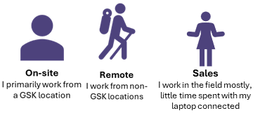
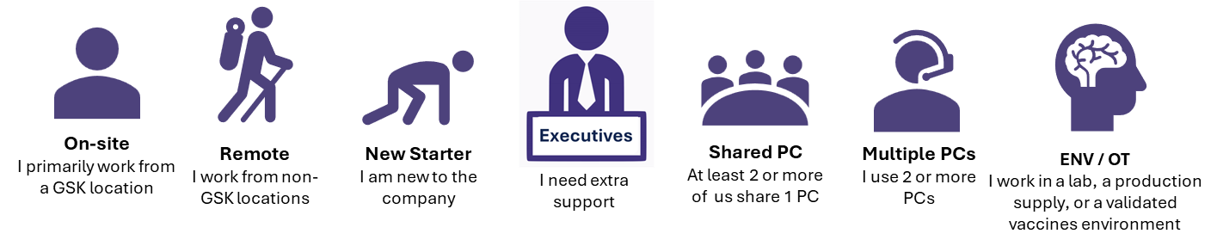
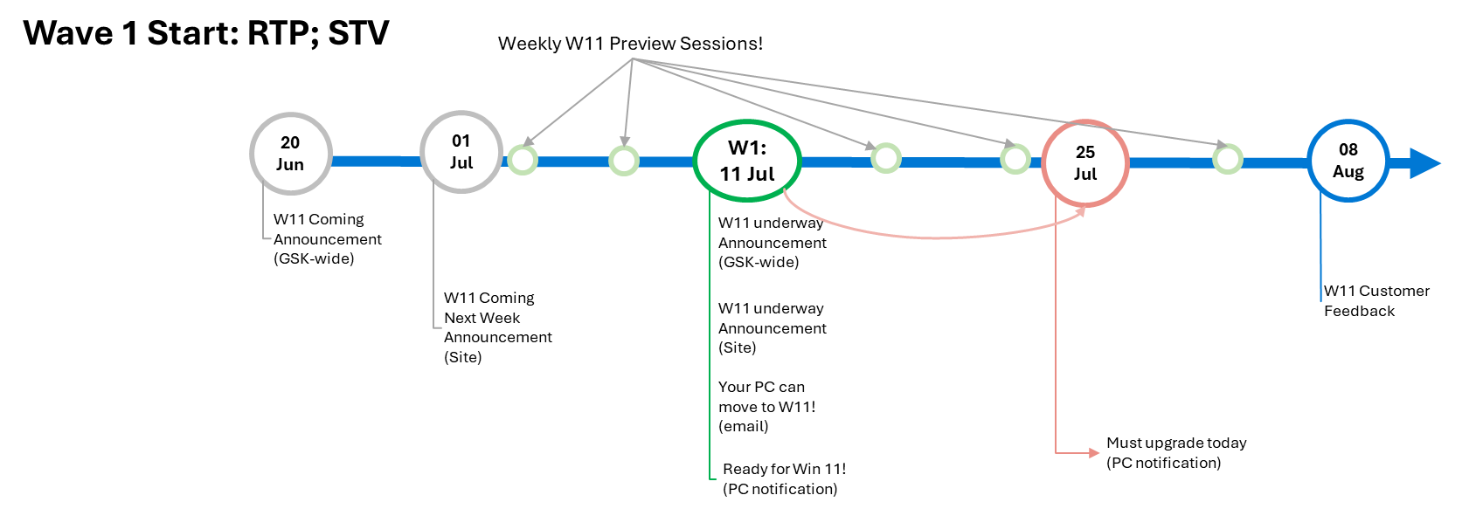
Comms
Comms Strategy
Just-in-time communications Clear, concise & in plain, non-technical language Direct email & Getting Started Guide will be available in Arabic, Brazilian Portuguese, Chinese (simplified), English, French, German, Hindi, Italian, Japanese, Polish, Russian, Spanish, & Urdu. Focused on User Experience Journey Leveraging Release Personas
Comms Network
Win 11 website (single source of truth) SNOW Kbase (repository) Dashworks (email) Dedicated BU Tech Leads Service Partner Service Delivery Managers Win 11 Champions BU Finance Leads Tech Forum Exec Support Functional Comms Leads Windows PC OS Workplace Groups GSK Sites GSK News (TKTD) Chat to Tech Digital & Tech News GP&T News EUS LT IE LT Tech LT
Standard
Special Consideration
BAU
LTSC – 4Q24

Slide 9

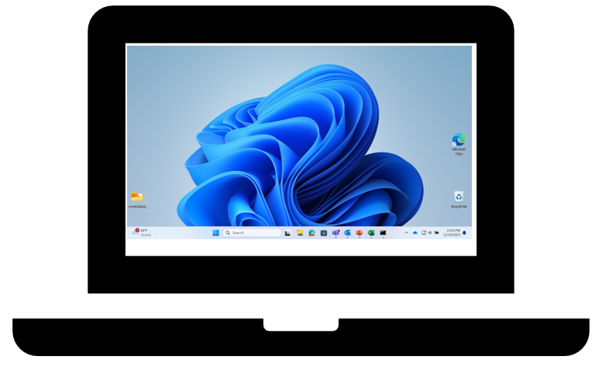

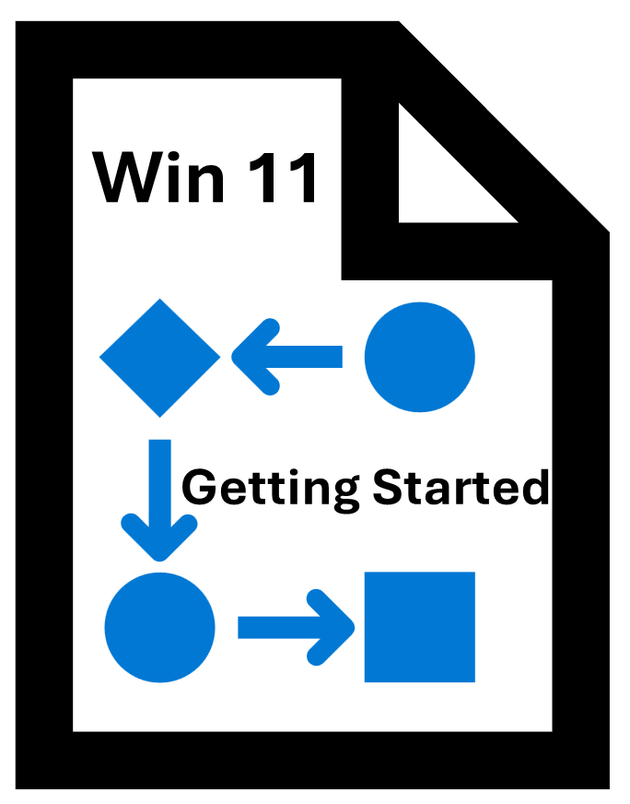




Windows 11 Enterprise-wide Comms
Announcements | Win 11 Preview Sessions | Site Toolkit | Getting Started with Win 11 (Instructions) | Win 11 New Features mini-videos | Direct email | Customer Feedback | Win 11 Progress Updates
Audience: All | Audience: All | Audience: Sites | Audience: All | Audience: All | Audience: All | Audience: Subset of W11 users | Audience: W11 Stakeholders
GSK News Channels Win 11 website Workplace Groups | Meetings [weekly for 1st few months, then biweekly, then monthly] | BU/Site Comms Channels Win 11 website | SNOW Kbase Win 11 website | SNOW Kbase Win 11 website Workplace Groups | Dashworks BU/Site Comms Channel | NexThink | Win 11 website Stakeholder Meetings Workplace Groups
Key Messages Win 11 is coming Attend a Preview Session | Key Messages When will I get Win 11? What will that look like? (UX) How long will it take? What changes? How will it help or enhance my daily work? Act quickly when you see your email | Key Messages Win 11 deployment begins at site (or with BU) on DD-MMM-YYYY Attend a Preview Session Act quickly when you see the email | Key Messages What is happening and when? What do I do if my PC needs to upgrade? What do I do if my PC needs to be replaced? How long with it take? How do I get help if I encounter an issue? | Key Messages Mini-videos highlighting a Win 11 New Feature | Key Messages Do I upgrade my PC or get it replaced? Act right away How do start the process? How long will it take? How do I know when it’s finished? | Key Messages Rate your experience (1-5 scale) regarding several categories Overall experience Ease of Migration Comms Preview Sessions Reinstalling BU App | Key Messages Progress by BU Burndown chart Target vs Actual

Slide 10
Win 11 Train the Trainer: Deployment
Upgrade PC
Download → Precached
Toaster
15-day window →
W11 Clean Install → OS
Autopilot registration → Instlled→ ESP Build Componenets
GSKSync restoration
Known issues

Slide 11
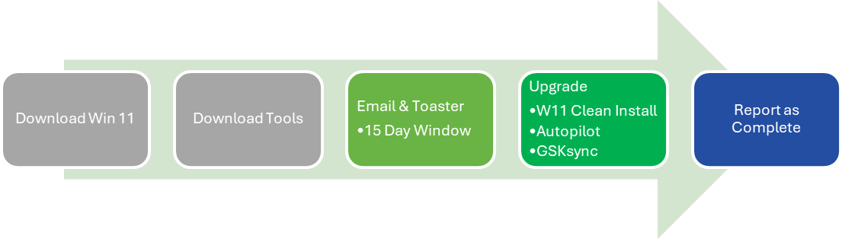
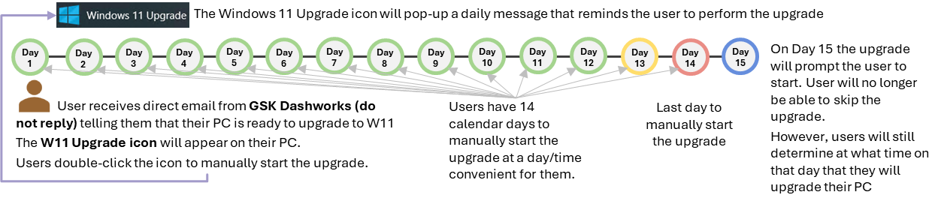
Deployment: Upgrade PC
Move 90% of eligible PCs to W11 by 31 Dec 24
OUTDATED GRAPHIC
There is a 15-day window NOT 21-day window

Slide 12
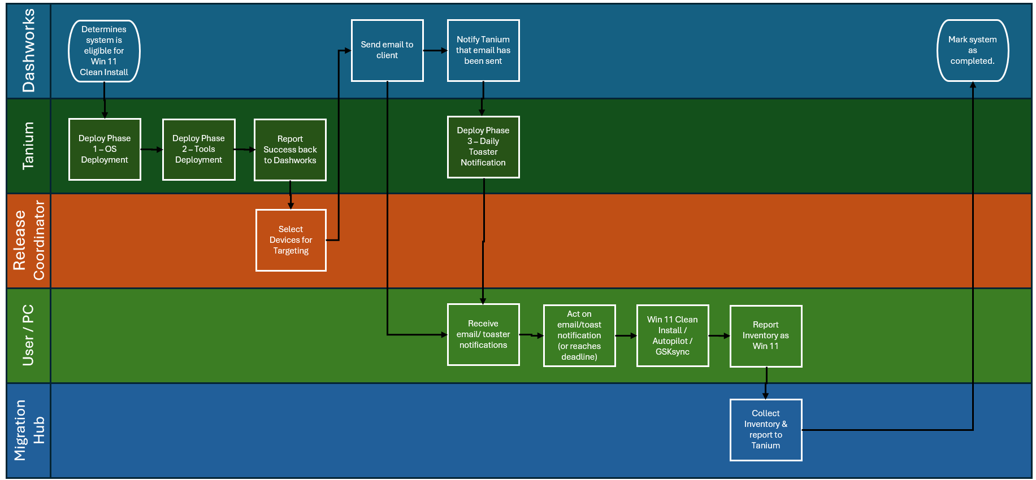
Win 11 Upgrade PC Workflow

Slide 13
Win 11 Train the Trainer: Deployment
Replace PC: Direct Ship
Order
OEM Order & Ship
Support
Return
Known issues
Who is impacted

Slide 14






Windows 11 Direct Ship
1
Order
End User Places Order in ServiceNow
3
Support
ServiceDesk (not local HCL on-site techs)
2
OEM Config & Ship
Windows 11 AP Build & Drop in QR Code, OEM Direct Ships PC to users home in 12 countries
4
Return
IT Asset Disposal & Global PlanITROI partnership by market

Slide 15






Windows 11 Order
User Notification
User Requests in SNOW
Manager Approval ?
Request sent to OEM
OEM Kits & Ships
User is notified they are eligible for upgrade with link to ServiceNOW request form
User submits request with desired model
Form is submitted to manager for approval (if non-standard)
Request sent to OEM or local support teams (Mac & Dell)
Laptop shipped to user via OEM

Slide 16




OEM Configuration Prep and Deployment
OEM Receives Request from GSK
OEM Hardware Preparation
Stage AutoPilot Build
Kit Laptop & QR Code
Ship Laptop to End User
Receives Request from GSK ServiceNow
Builds & Preps requested hardware
Registers AP Hash & Stages build
OEM kits Laptop & QR Code
OEM ships Laptop to End User

Slide 17


Support Model via ServiceDesk
ServiceDesk
Tech Hub
User Received Laptop from OEM
If the issue can’t be resolve by ServiceDesk, user can come to onsite to work with GSO on site support
Laptop will be shipped to user’s doorstep
End users must work with the Service Desk for first level support

Slide 18




End user Laptop Return to Global ITAD Partner
User process laptop buyback / return
User purchase / return
Asset Reconciliation
PlanITROi Receives Laptop
Drop off or Pick-Up via Fed Ex or UPS
User goes to Hardware buyback / Laptop return website
User purchases old PC or user requests return label.
Drop off / pick up via UPS or user directed to email/ form for remote wipe. (transaction #)
PlanITROI receives the laptop or asset is remotely wiped
PlanITROI provides weekly audit report

Slide 19
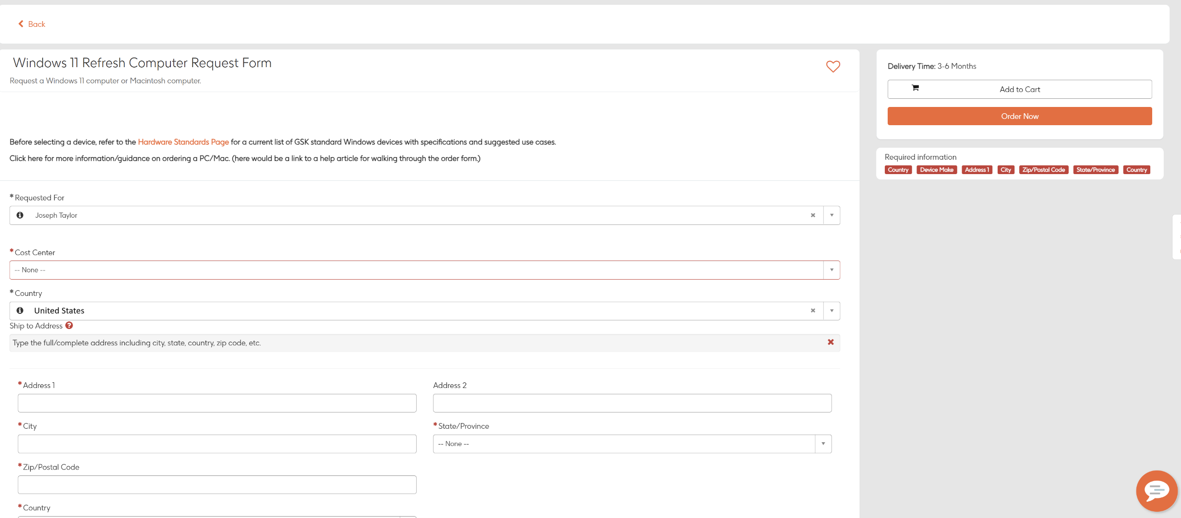
Windows 11 Request Form
The request for the new form has been submitted and is underway
Dev Draft

Slide 20

The Details
Ways of working
Questions/ FAQ
Direct Ship 12
Australia – 114
Belgium – 6125
Canada – 448
China – 1125
France – 1382
Germany – 596
India – 982
Poland – 495
Singapore – 991
Spain – 725
United Kingdom – 5495
United States – 5670
Direct Ship 12 – Weekly orders by US Order Desk, 1 per country with corresponding import sent to OEM’s
Delivery will be 3-6 weeks for each device/ planned refresh. User will get updates from OEM via email.

Slide 21
Win 11 Train the Trainer: Deployment
Replace PC: Legacy
Who is impacted
BAU activity
How to request a New/Upgrade, Swap, or Loan Computer
Known issues

Slide 22
Win 11 Train the Trainer: Deployment
Troubleshooting
W1 Support Staff RACI
Troubleshooting Tools
Tickets
Escalation Paths

Slide 23
Win 11 Support RACI
see RACI details here
 |  | Tooling | BU stakeholders | End User | GSK Help Desk (L1) | GSK Help Lounge (L2) | GSK Tanium Engineers | GSK W11 Engineering | HCL Build Team | HCL MW Deployment Operations | Juriba Consultants | Leadership | Release Coordinator | Tanium PO | W11 Automation Development Team | Windows OS PO
 | Assignment Group (Where applicable) (PS = Primary Support) |  |  |  | Multiple | Multiple | EndPointTanium-L2 |  | PC-Build-L2 | PC-ReleaseMgt-L2
 | Process Steps
1 | Determines system is eligible for Win 11 Clean Install | Dashworks | CI |  |  |  |  |  |  | A | R (PS) |  | C |  |  | C
2 | Deploy Phase 1 – OS Deployment | Tanium | I |  |  |  | R (PS) | C |  | A |  |  | I | I | C | I
3 | Deploy Phase 2 – Tools Deployment | Tanium | I |  |  |  | R (PS) | C |  | A |  |  | I | I | C | I
4 | Report Success back to Dashworks | Tanium Dashworks | I |  |  |  | R (PS) | C |  | A | R (PS) |  | I | I | C | I
5 | Select Devices for Targeting | Dashworks | I |  |  |  |  |  |  |  | R (PS) |  | AI | I |  | I
6 | Send email to client | Dashworks | I |  |  |  |  |  |  | A | R (PS) |  | I | I |  | I
7 | Notify Tanium that email has been sent | Dashworks Tanium | I |  |  |  | R (PS) | C |  | A | R (PS) |  | I | I | C | I
8 | Deploy Phase 3 – Daily Toaster Notification | Tanium | I |  |  |  | R (PS) | C |  | A |  |  | I | I | C | I
9 | Receive email/ toaster notifications |  |  | A | R (L1) | R (L2) |  | C |  | R (L3) |  |  |  |  | C
10 | Act on email/toast notification (or reaches deadline) |  |  | A | R (L1) | R (L2) |  | C |  | R (L3) |  |  |  |  | C
11 | Win 11 Clean Install / Autopilot / GSKsync | Tanium MS AutoPilot Process | I | I | R (L1) | R (L2) | R (L3.5+) | ARC (L3.5+) | R (L3.5+) | R (L3) |  |  | I | I | RC (L3.5+ Temp) | I
12 | Report Inventory as Win 11 | Tanium Intune | I |  |  |  | R (PS) | R |  | AR |  |  | I | I |  | I
13 | Collect Inventory & report to Tanium | Tanium Intune Migration Hub | I |  |  |  | R (PS) |  |  | A |  |  | I | I | CR | I
14 | Mark system as completed | Dashworks | CI |  |  |  |  |  |  | A | R (PS) | I | I | I | C | CI
15 | Web Enrollment Tool | IWH SQL Tanium | I |  | R (L1) | R (L2) | R (L3.5+) | ARC (L3.5+) |  | R (L3) |  |  | I | I | RC (L3.5+ Temp) | I

Slide 24
Win 11 Train the Trainer: Deployment
User Login experience: Tech - How to first login to the autopilot build Support Image build for unknown devices: Tech - Getting started with the Enrollment and Build Instructions for Autopilot Devices GSKsync Troubleshooting: GSKsync 10 Troubleshooting | Windows 11 Troubleshooting & Support from Intune : How To Use Microsoft Intune Windows MDM Portal to support Autopilot Windows PCs Tech - How to - The Intune troubleshooting guide for users of Autopilot at GSK Tech - Tech - How to - build a shared Windows 11 PC Tech - How to - Microsoft Intune Management Extension – Win32 Apps Windows 11 Troubleshooting : How to - Change the Wi-Fi Networks during Autopilot Build Process

Slide 25
Win 11 Train the Trainer: Deployment
Questions?
Review question in the chat & the room
Please take the poll in the chat after the meeting.

